Slide 1
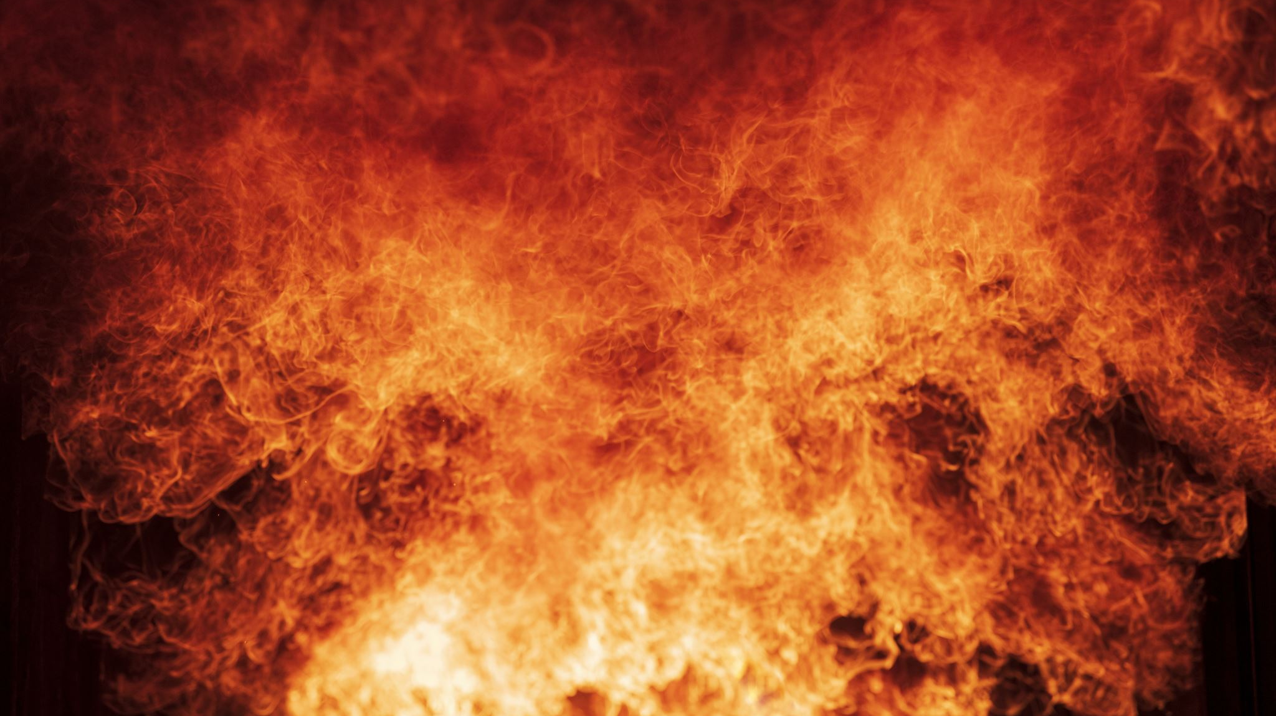
Charge up to a fire
How batteries are destroying property and lives.

Slide 2
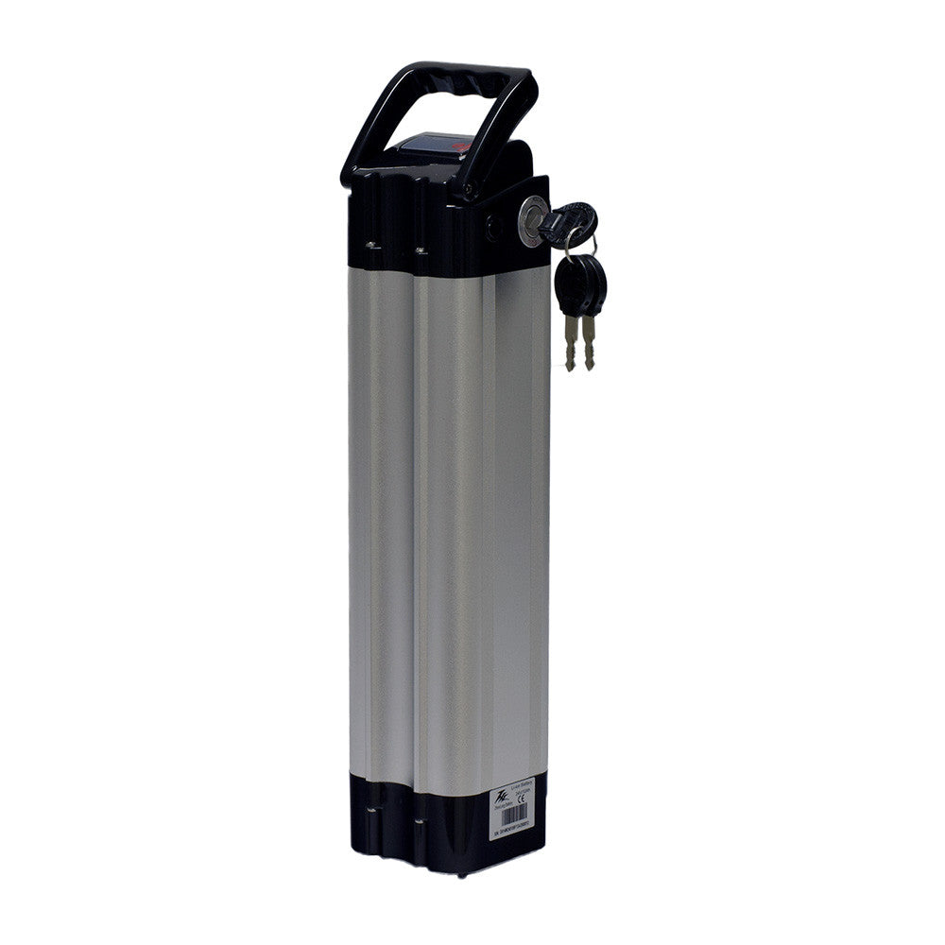
Lithium-ion Batteries
-Used by thousands of e-bikes and e-scooters in New Yorkers for easy and cheap transportation around the city.
-General price range is from 100-600 USD.
-Are bigger than the usual batteries found in cellphones, tablets and laptops.

Slide 3
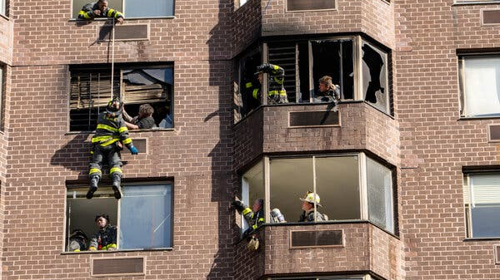
Issues
In 2022 it is reported that batteries caused 216 fires that led to 147 injuries and 6 deaths. As of Feb. 27, there have been 30 fires, 40 injuries and 2 deaths.
Not all batteries are made by manufacturers that have designed safety specs.
Wear and tear from the use causes batteries to damage and increase the risk of a fire.
It takes one cell to be either overheated or damaged to cause a fire.

Slide 4
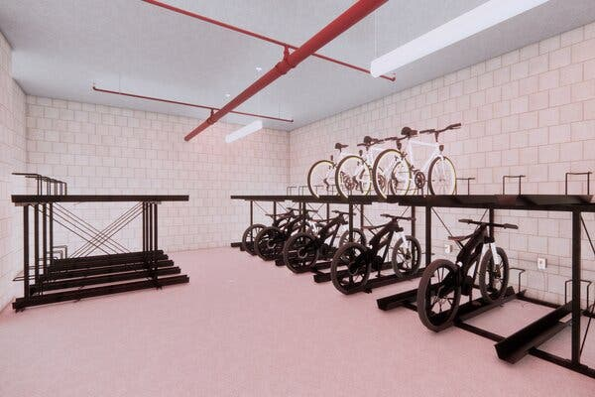
Proposes
Ban e-bikes and e-scooters from premises.
Have separate rooms specifically for e-bikes in buildings
Have e-bikes registered and inspected before the sale of bikes.
Use original charger cords from manufacturers
Have e-bike charging stations around the city.
Design Concept for storage rooms inside buildings.

Slide 5
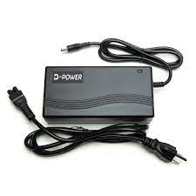
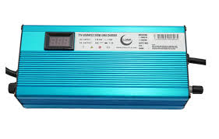
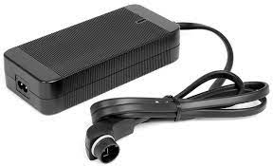
Not All are built the same
Every battery is not built the same and neither are the charger cords.
Guess which one is the safest?
You guessed right!!!!
This one shuts down when the battery is full. It has many settings that allow you to control charge speed.
Other two are simple and do not offer same protection.

Slide 6
Proposed Idea
Have all new bikes to be required to sell e-bikes with chargers that specific feature of stopping when the battery is full.
This would be done by passing regulation and fining offenders who do not comply with the law.

Slide 7
Conclusion
There many things that we can do to prevent from these fires happening and there will be a change due that officials are already taking steps to fix this.

Slide 8
Thank you for your time!!!

