Slide 1
Analysis of Noise Pollution in a University Library Setting
Can environmental noise affect cognitive function?
Physics Project | Presented by Osvaldo Tapia,
May 15, 2023

Slide 2
OUTLINE
Background
Objectives & Hypothesis
Materials & Apparatus
Procedure
Experimental
Collected Measurements
Results
Conclusion/Discussion

Slide 3
BACKGROUND
Noise is usually defined as undesirable sounds that can have adverse effects on human health and well-being. It can also have a disruptive and destructive impact on cognitive function. Noise levels exceeding 140dB can cause hearing damage in adults.
In shared learning spaces, it would be ideal for noise pollution to be at a minimum so as to not abate a students’ performance. Hostos Community College’s library served as the experimental space.

Slide 4
OBJECTIVES
To determine the speed and number of puzzle games can be completed within 30 minute increments.
To verify that they will be completed at a faster rate in less noisy areas.

Slide 5
HYPOTHESIS
If noise levels are high, the completion times for the puzzle games will be longer.

Slide 6
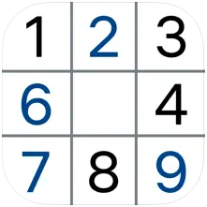
MATERIALS & APPARATUS
Apple iPhone (various models)
Smartphone Applications used:
- Decibel X:dB Sound Level Meter
- Sudoku.com
- notepad
Photo 1: Decibel X app
Photo 2: Sudoku.com app

Slide 7
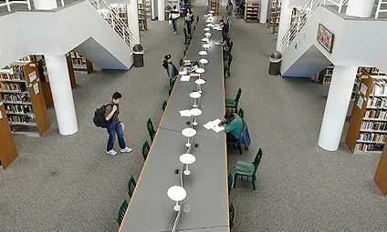
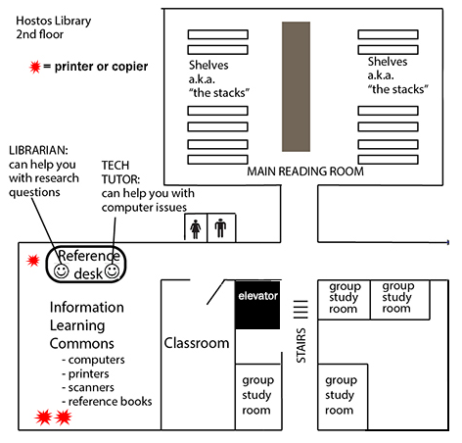
PROCEDURE
Photo 3: Main Reading Room
Photo 4: Library Floor Map
Experimenter’s position denoted with
Team members were stationed at different positions to obtain a set of readings. Noise levels were captured for 30 minutes as experimenters completed games on a separate smartphone.

Slide 8
COLLECTED MEASUREMENTS

Slide 9
RESULTS
There are similarities in data distribution if locations were on the same level. Note: despite being on opposite sides of an open area, The Stacks were nearly identical on Day Two.
The Group Study Room and Main Reading Areas are located on the more active lower level of the library.

Slide 10
CONCLUSION/DISCUSSION
On the quieter day, completion times were smaller but it’s not conclusive if less noise was the primary factor.
Visual external stimuli and the individual skill level of each experimenter must be taken into consideration.
Percentage error was not captured due to use of imprecise timers.

Slide 11
REFERENCES
Young, H., & Freedman, R. (2019). University Physics with Modern Physics (15th ed.). Pearson.

Slide 12
ACKNOWLEGEMENTS
Thank you
Natural Sciences Department – Eugenio Maria de Hostos Community College, City University of New York
Our fellow classmates

